Slide 1

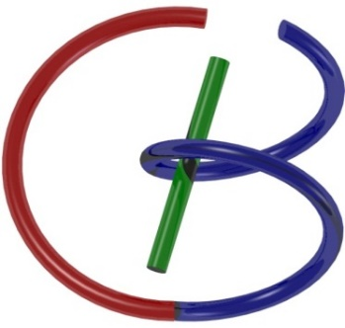
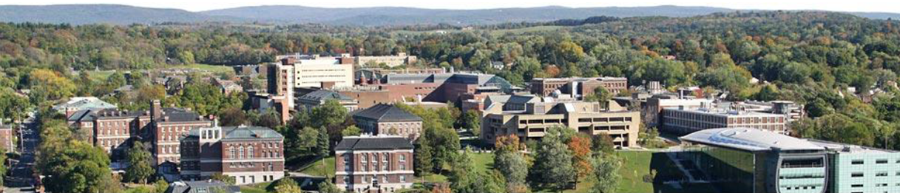
CT Image Reconstruction
Ge Wang
AI-based X-ray Imaging System (AXIS) Lab
Rensselaer Polytechnic Institute, Troy, New York, USA
September 28, 2021
Notes:
Hello, since Professor Wang has a conference today out of town, I will give this hands-on introduction based on this PPT we prepared together. As he mentioned last time, we will have deep learning final projects by the end of the semester. Tentatively, we will have five lectures on deep learning hands-on, including this one.

Slide 2
Outline
X-ray Nature
Wave
Particle
X-ray Attenuation
Mechanisms
Beer’s Law
X-ray Tubes/Sources & Detectors
Sources & Detectors
Breast Imaging Examples
Radiation Dose
Dosimetry
Low-dose CT

Slide 3
MI Schedule for F21
Tue | Topic | Fri | Topic
08/31 | Introduction | 09/03 | Neuron, Network & Backpropagation
09/07 | No Class | 09/10 | Hands-on 1: Python, Colab, & TensorF
09/14 | Architectures & Training | 09/19 | Hands-on 2: MNIST Classification
09/21 | Image Quality I | 09/24 | CT Physics
09/28 | CT Reconstruction | 10/01 | Deep CT Reconstruction
10/05 | Hands-on 3: CT Networks | 10/08 | More CT Contents
10/12 | MRI Physics | 10/15 | Spin-Echo
10/19 | K-Space Theorem | 10/22 | More MRI Contents
10/26 | Mid Exam | 10/29 | Deep MRI Reconstruction
11/02 | Hands-on 4: MRI Networks | 11/05 | Nuclear Physics
11/09 | Nuclear Imaging | 11/12 | US Imaging
11/16 | Optical Imaging | 11/19 | Multimodality Imaging
11/23 | Hands-on 5: Image Conversion | 11/26 | Thanksgiving
11/30 | Image Quality II | 12/03 | Stability, Interpretability, & Others
12/07 | Overview | 12/10 | Final Exam
Office Hour: Teaching Day 5-6pm: https://rensselaer.webex.com/meet/wangg6

Slide 4
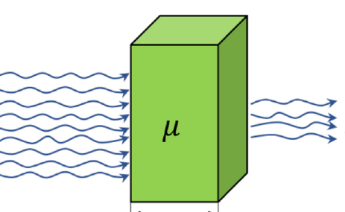
Derivation of Beer’s Law

Slide 5
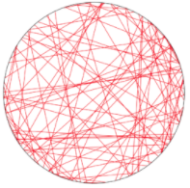
System of Linear Equations

Slide 6
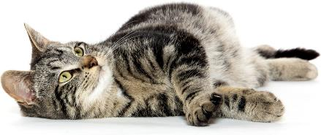
Computed Tomography
Radon Transform
Computed tomography (CT): Image reconstruction from projections
y
p(θ,t)
t
p(θ,t)
f(x,y)
θ
x
f(x,y)
X-rays
Computerized Axial tomography (CAT)

Slide 7
Outline
Filtered Backprojection (FBP)
Fan-beam Case
Heuristic Extension
Mammography, Breast Tomosynthesis & CT

Slide 8
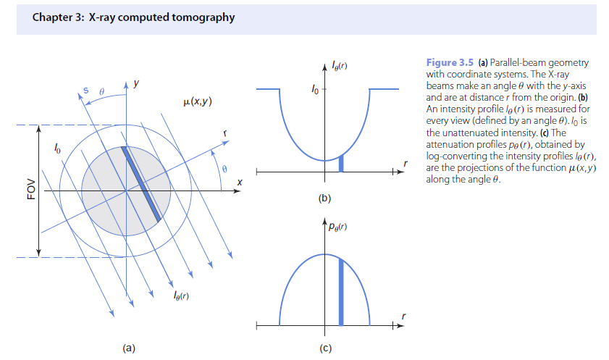
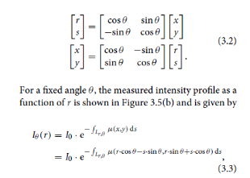
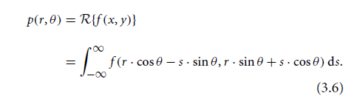
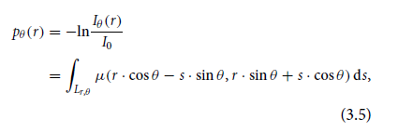

Slide 9
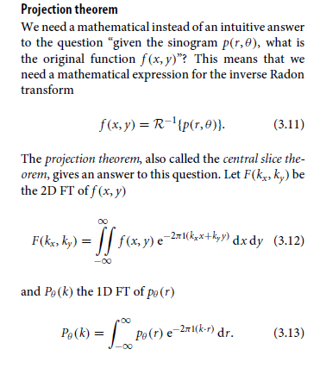
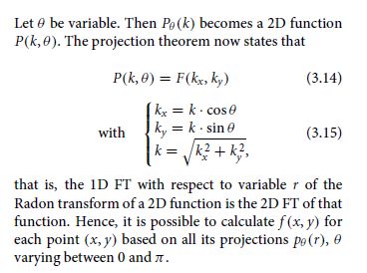
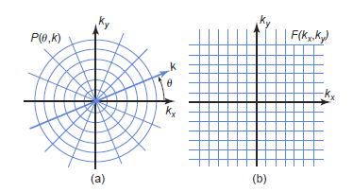
Fourier Slice Theorem

Slide 10
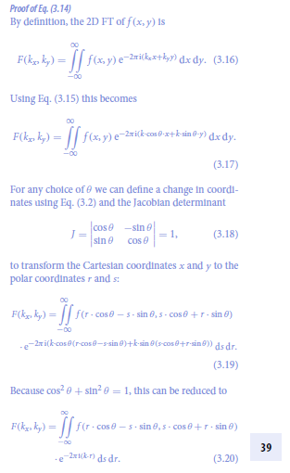
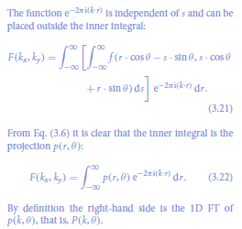

Slide 11
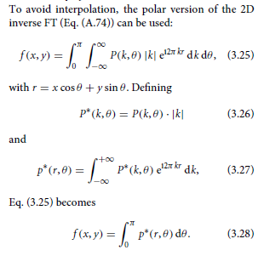
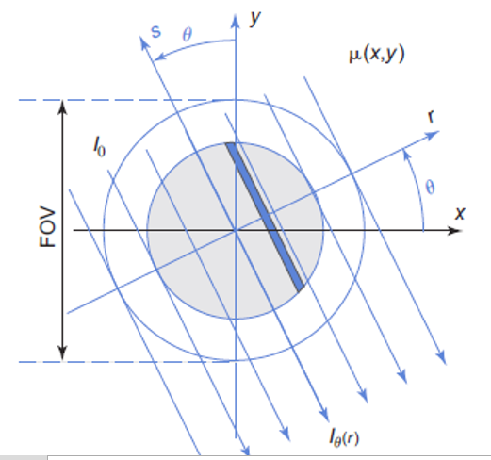
Parallel-beam FBP

Slide 12
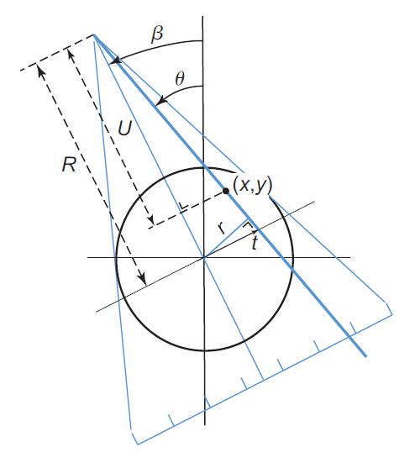
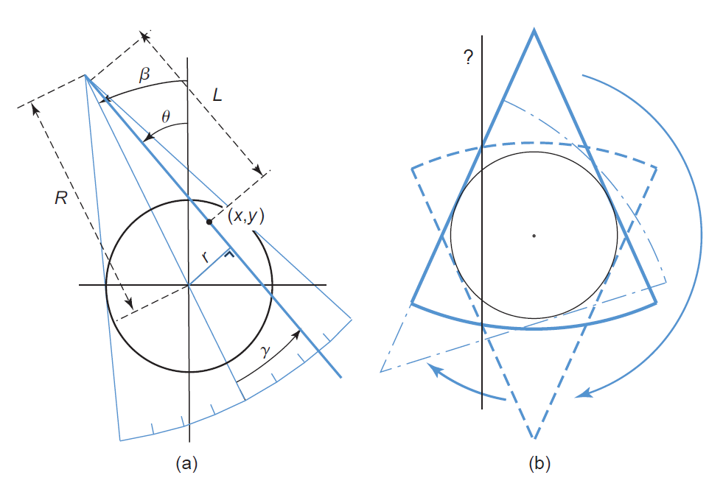
Equi-angular/spatial Fan-beam Geometry
Homework on Half-scan

Slide 13
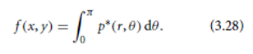
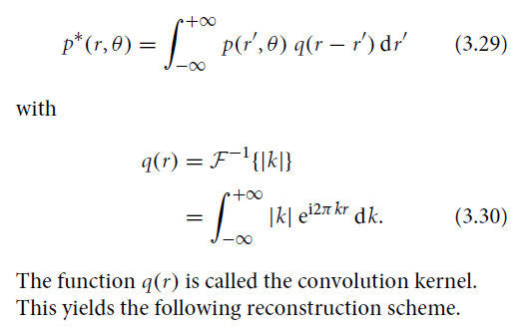
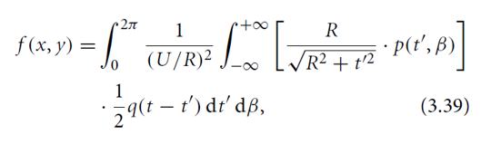
Parallel- to Fan-beam FBP
Parallel-beam
Filtered Backprojection
Key Idea: Convert Parallel-beam Data to Fan-beam Data
Fan-beam
Filtered Backprojection

Slide 14
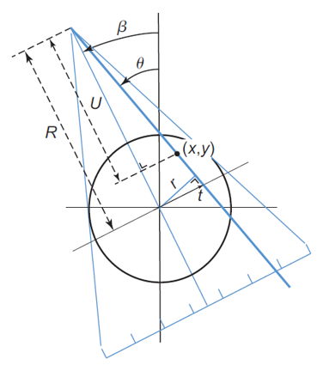
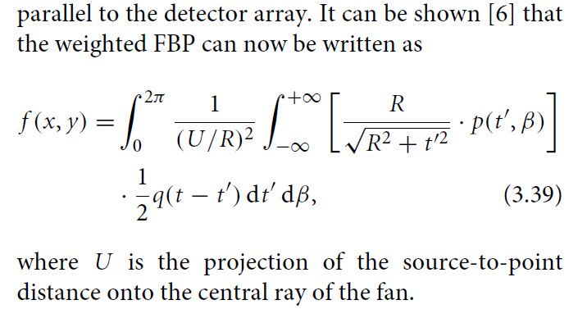
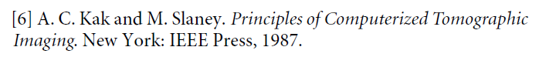
Equi-spatial Fan-beam Formula

Slide 15
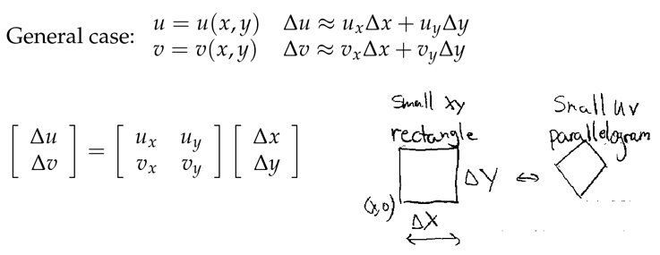
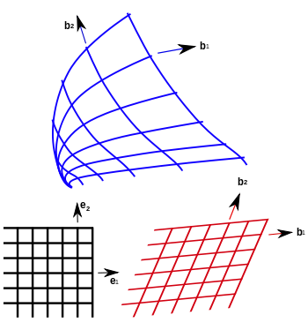
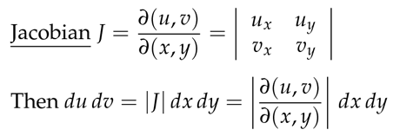
Fan-beam FBP = Parallel-beam FBP
Key Idea: Convert Parallel-beam Data to Fan-beam Data

Slide 16
Fan- to Parallel-beam FBP
Parallel-beam
Filtered Backprojection
Key Idea: Convert Fan-beam Data to Parallel-beam Data or We Do It Heuristically!
Fan-beam
Filtered Backprojection

Slide 17
Heuristics behind the Fan-beam Formula
If you want to see directly the correctness of the fan-beam formula, you can read the rest of the slides.
The key idea is that if we just consider a point object near the system origin, then all the factors in the fan-beam formula becomes immediately clear!
And that understanding is valid no matter the source to the original distance is large or small. Hence, we got a generalized fan-beam formula!

Slide 18
Equi-spatial Fan-beam Formula

Slide 19
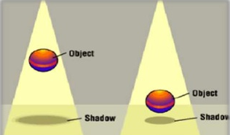
Delta Function on a Scaled Axis
Projecting with a Divergent Beam: The Impulse Becomes Stronger (Larger Area)

Slide 20
Delta Function on a Tilted Axis
Projecting onto a Tilted Plane: The Impulse Becomes Stronger (Larger Area)

Slide 21
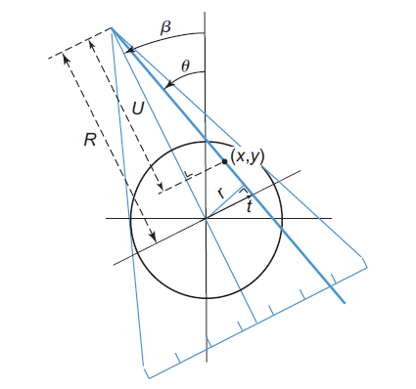
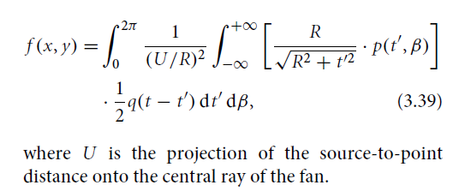
Obliqueness of the Detector Array

Slide 22
Divergence of the X-ray Beam
This Scaling Factor Applies the Same Way from the Opposite View Angles (Generally Speaking, Either Magnified or De-magnified Depending on Which Side)

Slide 23
Difference Between θ & β Angles
For Simplicity, Let Us Only Consider the Impulse (Red) Near the System Origin

Slide 24
From Full-scan to Half-scan
Full-scan Fan-beam Dataset (360˚) Consists of Two Parallel-beam Datasets (180˚)

Slide 25
Equi-spatial Fan-beam Formula

Slide 26
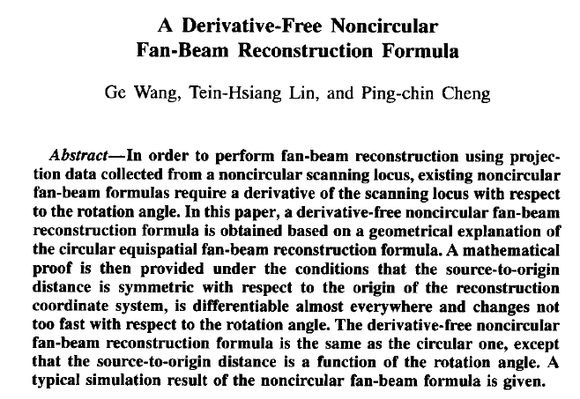
Extended Fan-beam Formula

Slide 27
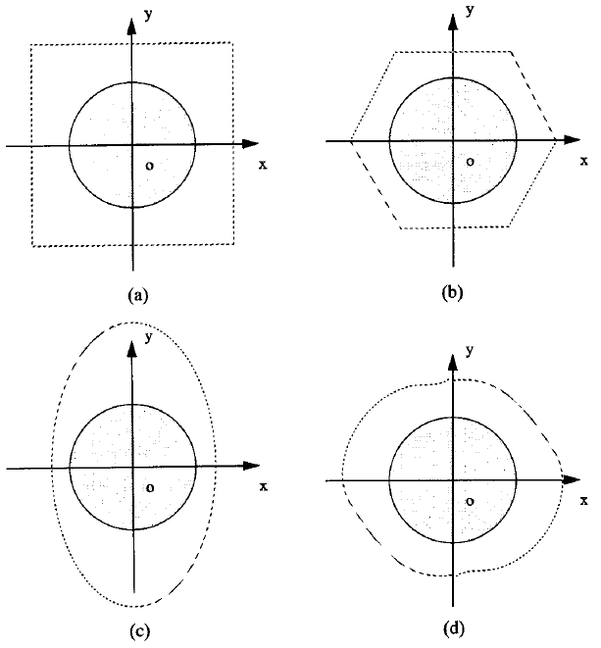
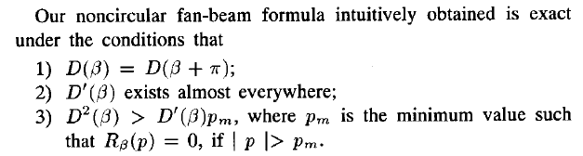
More General Scanning Trajectory

Slide 28


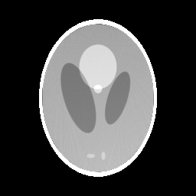
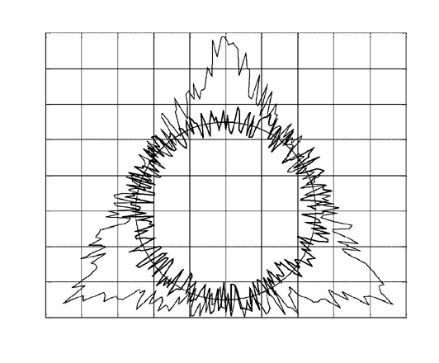
Simulation Results
Circle-like and triangle-like random scanning loci
True slice from the 3D Shepp-Logan phantom
Computed using the circle-like locus
Computed using the triangle-like locus
Effectiveness of the derivative-free noncircular fan-beam reconstruction (256² pixels, 256 projections, 256 detectors)

Slide 29
Outline
Filtered Backprojection (FBP)
Fan-beam Case
Heuristic Extension
Mammography, Breast Tomosynthesis & CT

Slide 30
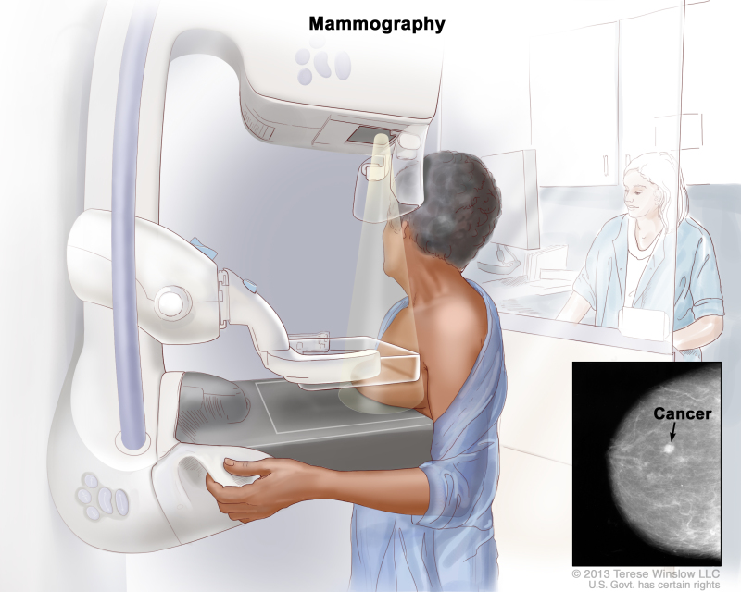

Radiography/Mammography

Slide 31
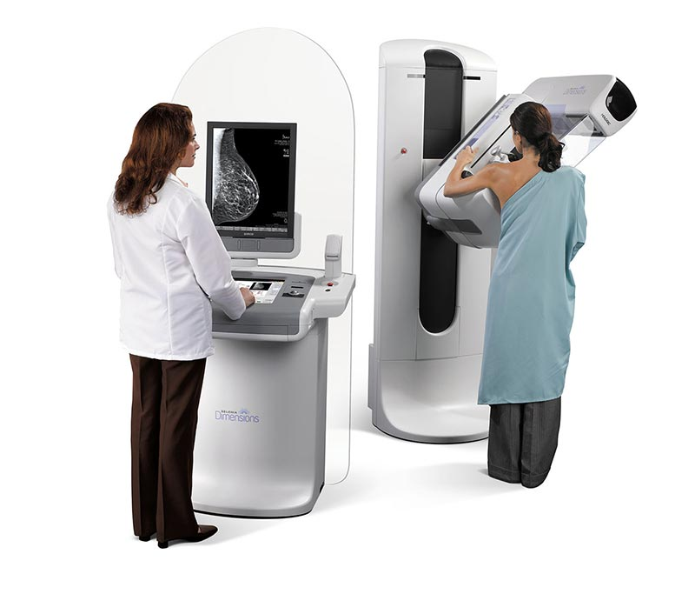
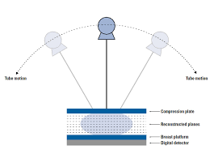
Breast Tomosynthesis
20-49kVp

Slide 32
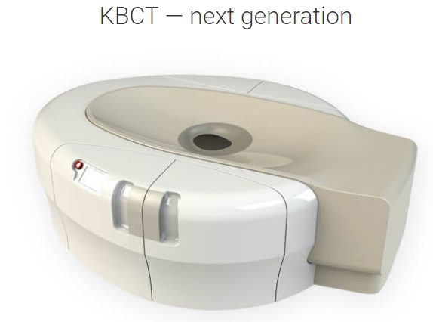
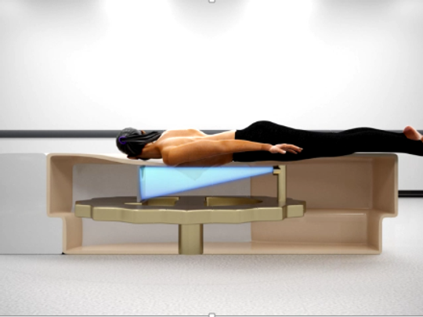
Breast CT
49kVp, 200mA, 8ms Pulse Width

Slide 33


Mathematical Insight
Radiography
(Single View)
Tomography
(Full Scan)

Slide 34

Mathematical Insight
Radiography
(Single View)
Tomosynthesis
(Limited Angle)
Tomography
(Full Scan)

Slide 35
Physical Insight
20-49kVp
49kVp
Radiography
(Lowest kVp)
Tomosynthesis
(Modest kVp)
Tomography
(Highest kVp)

Slide 36
Ballpark Analysis
Key Points
kVp should be low to maximize Δµ
kVp should be high to minimize noise

Slide 37
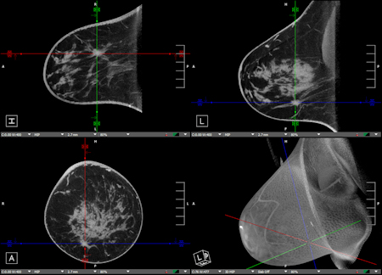

Koning Breast CT Images

Slide 38
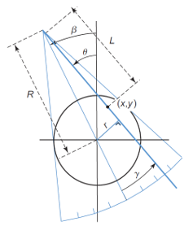
Homework
What is the angular range [0, x] for β so that fan-beam projection data meet the sufficient condition for image reconstruction? In other words, x=?

Slide 39
Homework
There is a mathematical error in my paper, please find it, and email me (I am curious to see who is the first)
https://ieeexplore.ieee.org/document/242365/

Slide 40
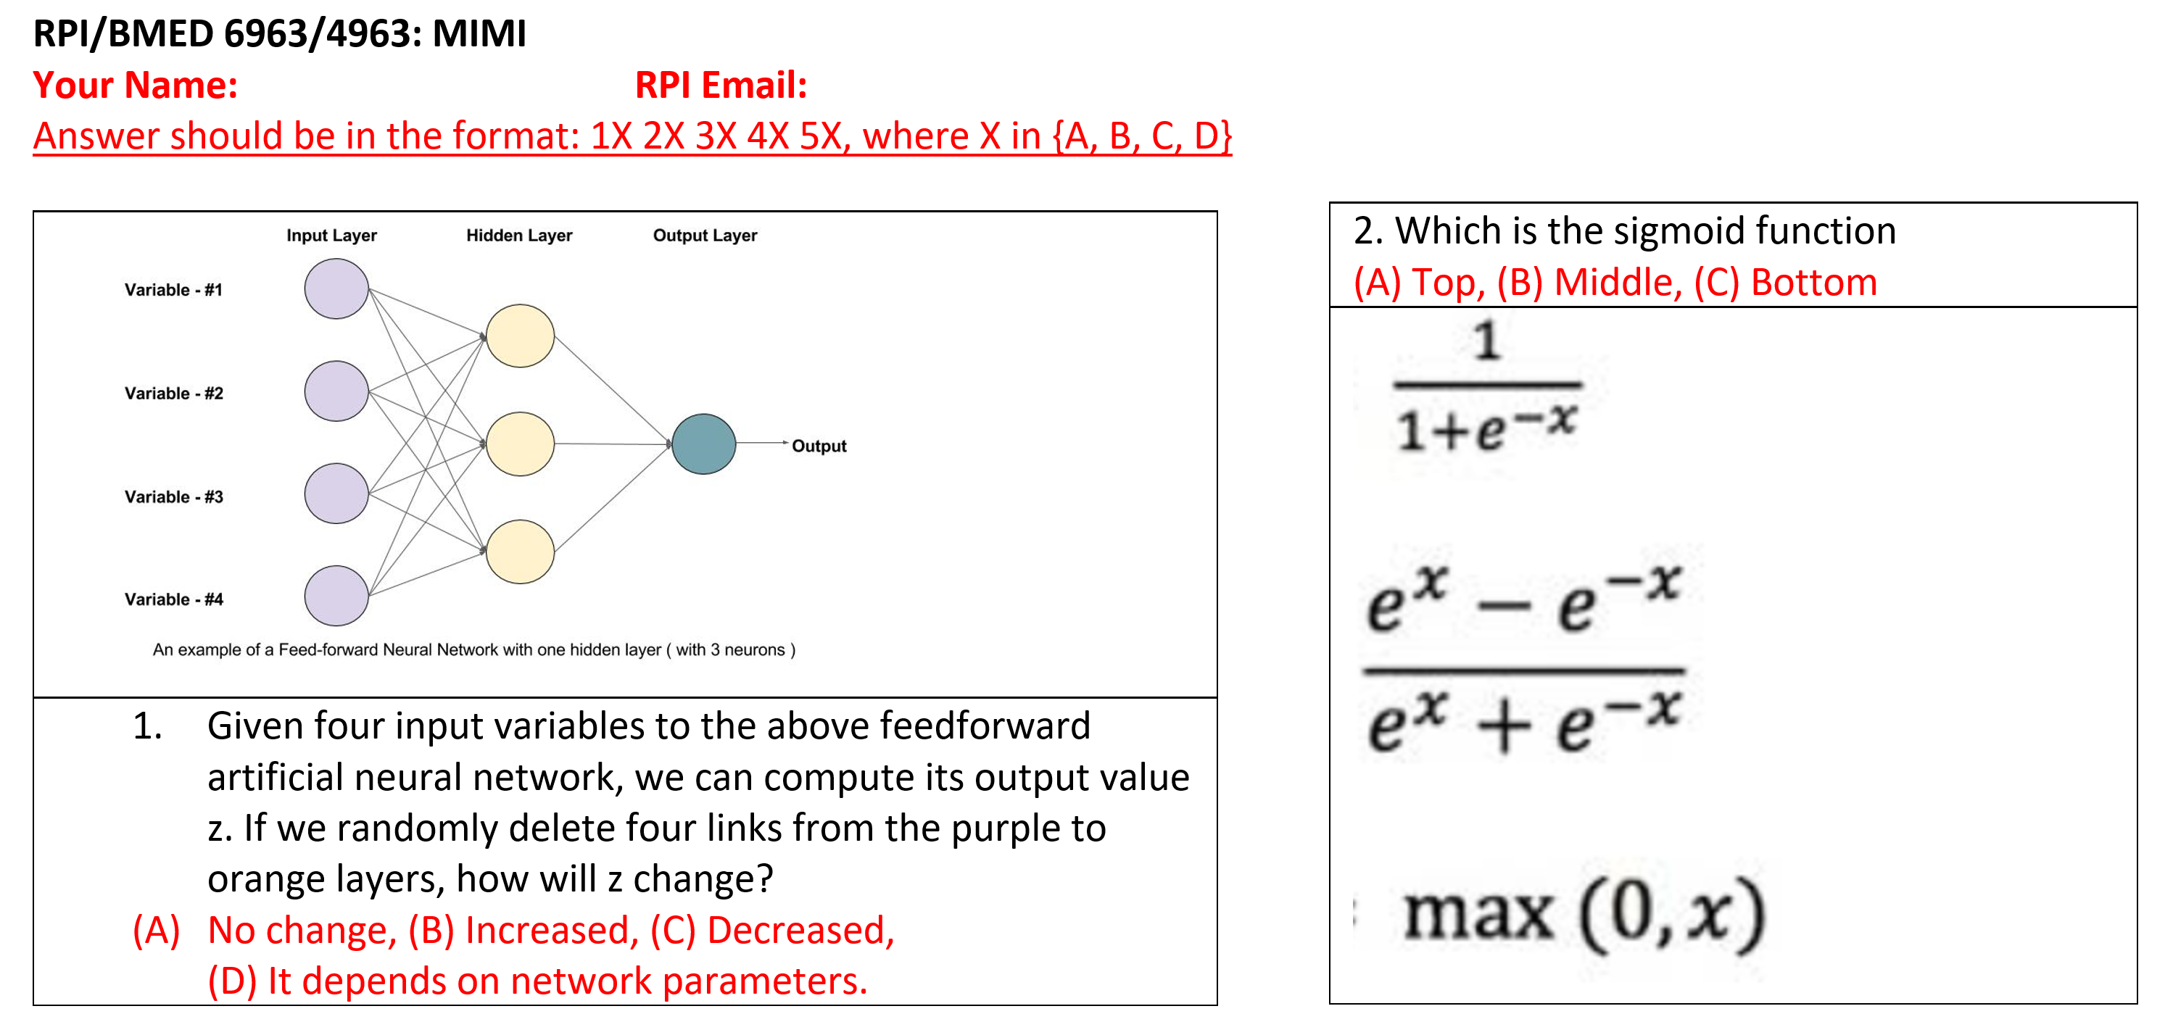

Slide 41
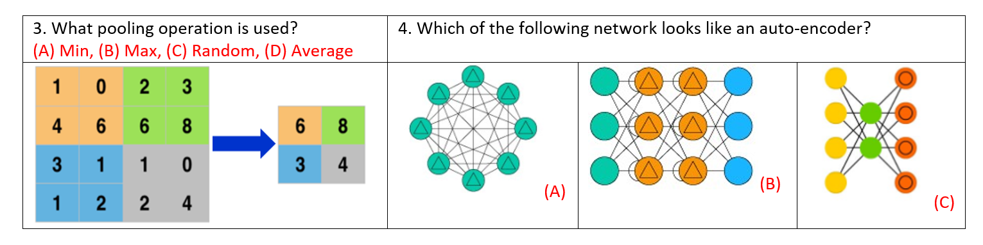

Slide 42
